Slide 1
Introduction to calculus for ML
Google developer student clubs
By : Sayed Azp

Slide 2
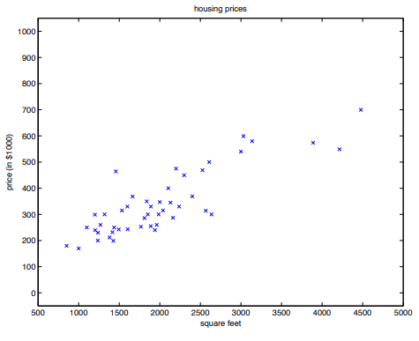
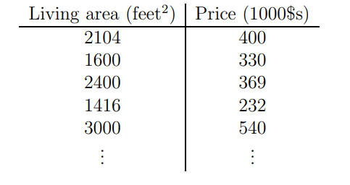
Why calculus ?
One word …… optimization

Slide 3
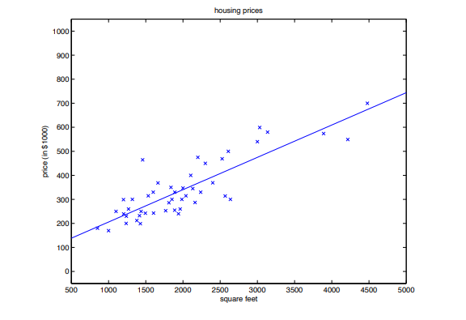

Slide 4
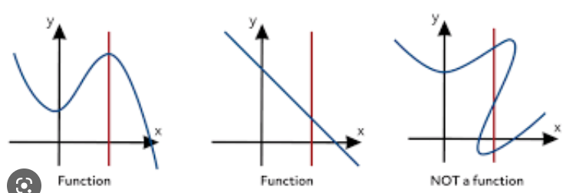
What’s a function !

Slide 5
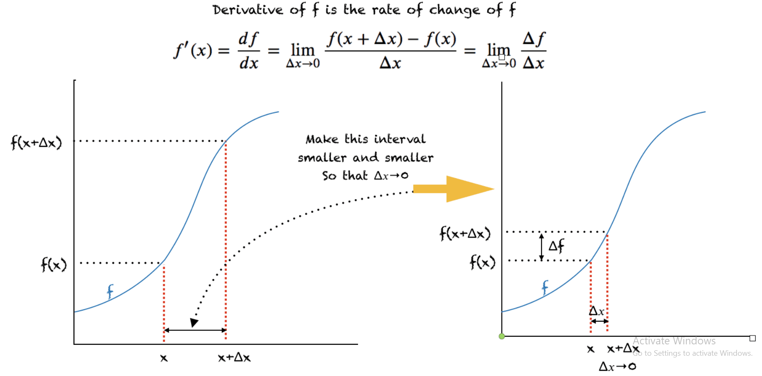

Slide 7
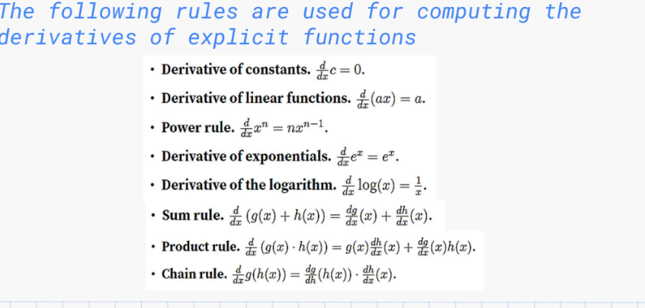

Slide 8
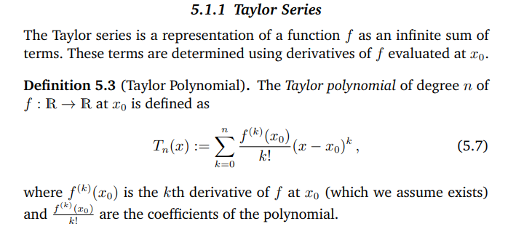
Taylor series .
Taylor series provides a method to approximate any function

Slide 9
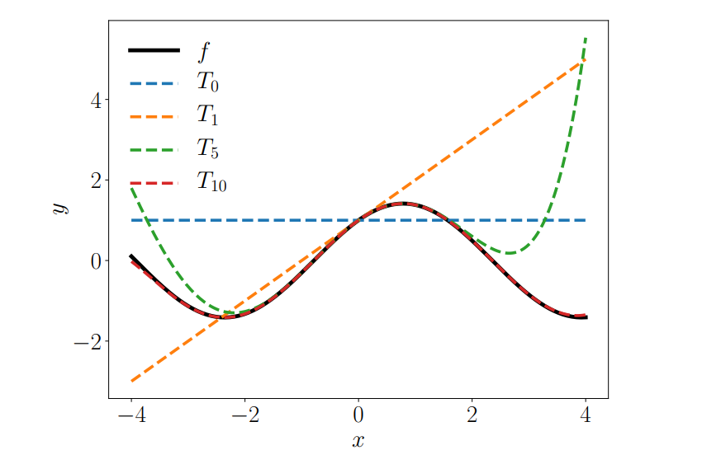

Slide 10
Taylor example !

Slide 11
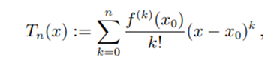

Slide 13
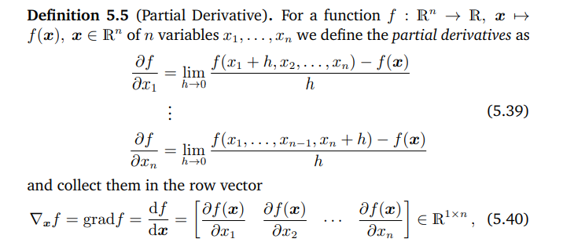
Moving to higher dimensions !
Differentiation as discussed in previous section applies to functions f of a scalar variable x ∈ R. In the following, we consider the general case where the function f depends on one or more variables x ∈ Rn , e.g., f(x) = f(x1, x2).

Slide 14
Example :
f(x, y) = (x + 2y ^3 )^ 2 , we obtain the partial derivatives

Slide 16
Example 2 :
Compute the gradient !

Slide 18
Attention in higher dimensions ! AX not the same thing as XA !

Slide 19
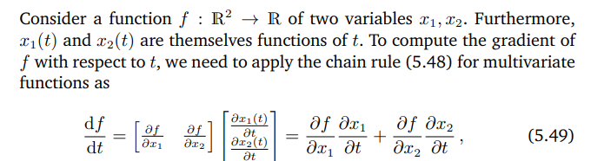
Chain rule in the new world

Slide 21
Example on chain rule !

Slide 24
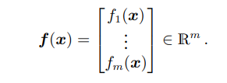
Vector valued functions (vector fields)
And what about functions that produces vectors !
1 to 1
Nto 1
N to M !

Slide 25
Example of vector valued function
f(x) = Ax
A ∈ R M×N , x ∈ R N

